Slide 1
Spirituality, Health and Well-Being
A Virtual Address for Inauguration of the
World Congress of Psychologists
Tamilnadu Chapter
Tamil Nadu, India
Doug Oman, Ph.D.
School of Public Health
University of California, Berkeley
dougoman@berkeley.edu
Slides to be posted on “Talks” tab at: http://dougoman.org

Slide 2
Questions
Why and how has the health world become interested in spirituality, health, and well-being?
In this regard, what might be the special heritage of India?
For India and the world, what are some pressing/needed tasks?

Slide 3
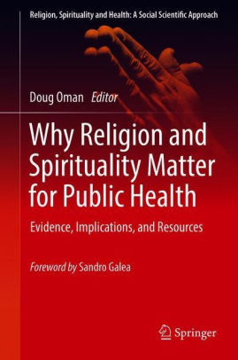
Health Outcomes linked to Spirituality/Religion
Mortality: ~20% reduced risk
  (HR=0.82, meta-analysis Chida et al, 2009)
Salutary Effects:
  Heart Disease and related processes (cardio reactivity, cholesterol, hypertension, stroke…)
  Cancer, Diabetes, Dementia, Disability, Self-Rated Health
  Depression, Anxiety, Suicide
Notes:
Oman, D. (Ed.). (2018). Why religion and spirituality matter for public health: Evidence, implications, and resources. Cham, Switzerland: Springer International. https://doi.org/10.1007/978-3-319-73966-3

Slide 4
Pathways: How might R/S affect health?
(what “mechanisms”?)
⇨
⇨
⇨
Physical
Health
Spirituality & Religion
R/S Coping
R/S Meditation
Mental Health
/ Character Strengths
 reduced stress

(“allostatic load”)
Moderated by Sociocultural CONTEXT
(Koenig, Larson & McCullough, 2001)
(Oman & Thoresen, 2002, 2007)
Notes:
*Koenig, H. G., McCullough, M. E., & Larson, D. B. (2001). Handbook of Religion and Health. New York: Oxford University Press.
***Oman, D., & Thoresen, C. E. (2002). "Does Religion Cause Health?": Differing Interpretations and Diverse Meanings. Journal of Health Psychology, 7(4), 365-380. doi:10.1177/1359105302007004326
***[a simplified form of the 2002 publication by the same authors:] Oman, D., & Thoresen, C. E. (2007). Does Religion Cause Health? In A. Eisen & G. Laderman (Eds.), Science, religion, and society: An encyclopedia of history, culture, and controversy (Vol. 2, pp. 685-695). Armonk, NY: ME Sharpe.

Slide 5
Cross-Cultural Corroboration: Sites
R/S ↔ smoking*? | Poland, Central America, Mexico, Iran, Israel, Lebanon, South Africa
R/S ↔ alcohol*? | Australia, Finland, Hungary, Poland, Spain, United Kingdom, Brazil, the Caribbean, Central America, Mexico, Israel, Lebanon, Thailand, Turkey, South Africa
R/S ↔ risky sexual activity*? | Australia, Slovakia, the Caribbean, Iran, Israel, Kenya, Malawi, Nigeria
R/S ↔ depression*? | Netherlands, Yugoslavia, Mexico, Iran, Israel, Palestine, Afghanistan, Taiwan
R/S ↔ anxiety*? | Germany, Israel, Afghanistan, Japan, Sri Lanka
R/S ↔ adult well-being? | Uruguay, Kuwait, India, Malaysia, Pakistan, 140+ worldwide
R/S ↔ youth well-being? | Australia, Ukraine, United Kingdom, India, Thailand, Cameroon
R/S ↔ hypertension*? | Greece, Italy, Netherlands, United Kingdom, West Indies, Egypt, Israel, Kuwait, Turkey, India, Japan, Taiwan, Thailand, South Africa
R/S ↔ self-rated health? | Bosnia, Denmark, Finland, Italy, Poland, Scotland, Caribbean, Latin America, Mexico, Israel, Taiwan
*reduced
Notes:
Grant, L., & Oman, D. (2018). International and global perspectives on spirituality, religion, and public health. In D. Oman (Ed.), Why religion and spirituality matter for public health: Evidence, implications, and resources (pp. 447-462). Cham, Switzerland: Springer International. https://doi.org/10.1007/978-3-319-73966-3_27

Slide 6
Inter-Religious Respect
Bhagavad Gītā 4:11
Whatever path men or women travel… it leads to me
ये यथा मां प्रपद्यन्ते तांस्तथैव भजाम्यहम् |
मम वर्त्मानुवर्तन्ते मनुष्या: पार्थ सर्वश: || 11||
ye yathā māṁ prapadyante tāns tathaiva bhajāmyaham
mama vartmānuvartante manuṣhyāḥ pārtha sarvaśhaḥ || 11||

Slide 7
Inter-Religious competence
Notes:
Srinivasan, M., Kaplan, E., & Dahl, A. (2019). Reasoning about the scope of religious norms: Evidence from Hindu and Muslim children in India. Child Development, 90(6), e783-e802. https://doi.org/10.1111/cdev.13102

Slide 8
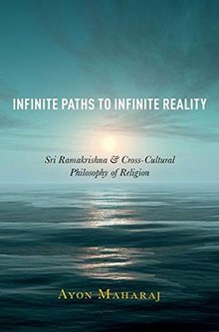
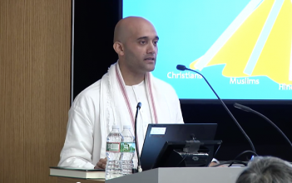
Inter-Religious Worldview: Philosophy
Ayon Maharaj (2018). Infinite paths to infinite reality: Sri Ramakrishna and cross-cultural philosophy of religion. Oxford University Press.
Photo: Princeton University, 2019
https://religion.princeton.edu/news/video-infinite-paths-to-infinite-reality-sri-ramakrishnas-vijnana-based-doctrine-of-the-harmony-of-all-religions/
Notes:
Maharaj, A. (2018). Infinite paths to infinite reality: Sri Ramakrishna and cross-cultural philosophy of religion. New York, NY: Oxford University Press. https://doi.org/10.1093/oso/9780190868239.001.0001

Slide 9
Tasks / Resources include
Study Spirituality-Health relations in India
Access Indian heritage resources
  Indian Psychology Movement
Pressing Practical Tasks
  Mental Health in Rural Populations
  Integrate Spirituality into Education
Tools to Jump-Start
  Special Issue (2018)
  Psychological Studies

Slide 10
Special Issue
⇦Research
Agenda
Review⇨
⇧
Empirical /
⇦ Case Studies
Etc.
Framework⇨
Notes:
*DeLuca, S. M., Kelman, A. R., & Waelde, L. C. (2018). A systematic review of ethnoracial representation and cultural adaptation of mindfulness- and meditation-based interventions. Psychological Studies, 63(2), 117-129. http://doi.org/10.1007/s12646-018-0452-z
*Oman, D., & Paranjpe, A. C. (2018). Indian spirituality: How relevant is Pargament's framework? Psychological Studies, 63(2), 140-152. https://doi.org/10.1007/s12646-017-0412-z
*Oman, D., & Singh, N. N. (2018). Combining Indian and western spiritual psychology: Applications to health and social renewal. Psychological Studies, 63(2), 172-180. https://doi.org/10.1007/s12646-016-0362-x (Viewable: http://rdcu.be/ldTE)

Slide 11
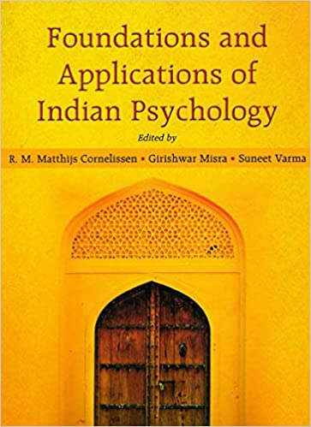
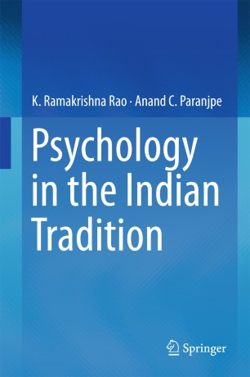

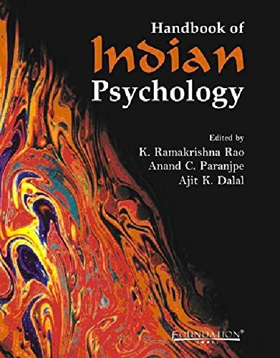
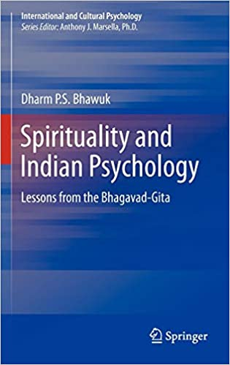
Indian Psychology
“a system/school of psychology derived from classical Indian thought”
…
Notes:
*Cornelissen, M., Misra, G., & Varma, S. (Eds.). (2014). Foundations and applications of Indian psychology (2nd ed.). Delhi: Pearson.
*Rao, K. R., & Paranjpe, A. C. (2016). Psychology in the Indian tradition. New Delhi; Heidelberg: Springer. https://doi.org/10.1007/978-81-322-2440-2
*Rao, K. R., Paranjpe, A. C., & Dalal, A. K. (Eds.). (2008). Handbook of Indian psychology. New Delhi: Cambridge University Press India. https://doi.org/10.1017/UPO9788175968448
*Bhawuk, D. P. S. (2011). Spirituality and Indian psychology: Lessons from the Bhagavad Gita. New York, NY: Springer. https://doi.org/10.1007/978-1-4419-8110-3
*Rao, K. R. (2017). Foundations of yoga psychology. Singapore: Springer Nature. https://doi.org/10.1007/978-981-10-5409-9

Slide 12
Summary
Spirituality + health = key frontier
Spiritual factors ⇨ can be highly consequential
World (and India) needs India’s spiritual heritage
Indian psychologists well-positioned
THANK YOU
Slides posted on “Talks” tab at: http://dougoman.org

Slide 13
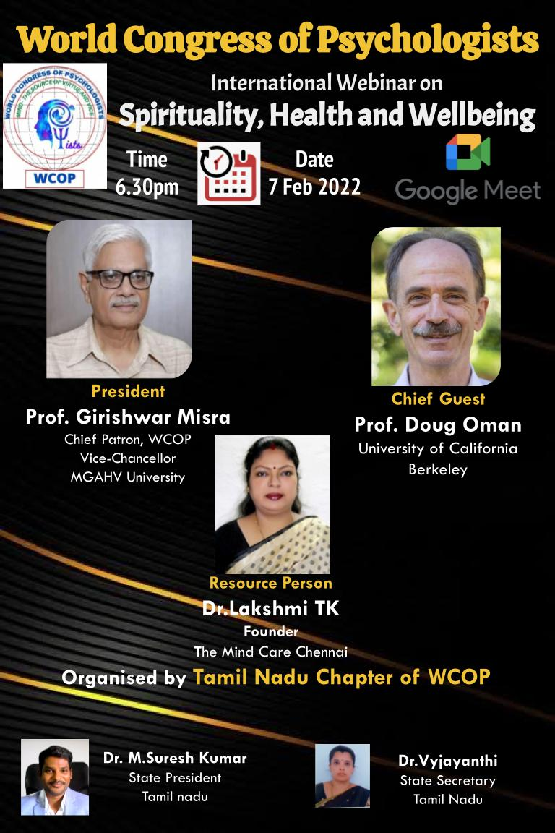
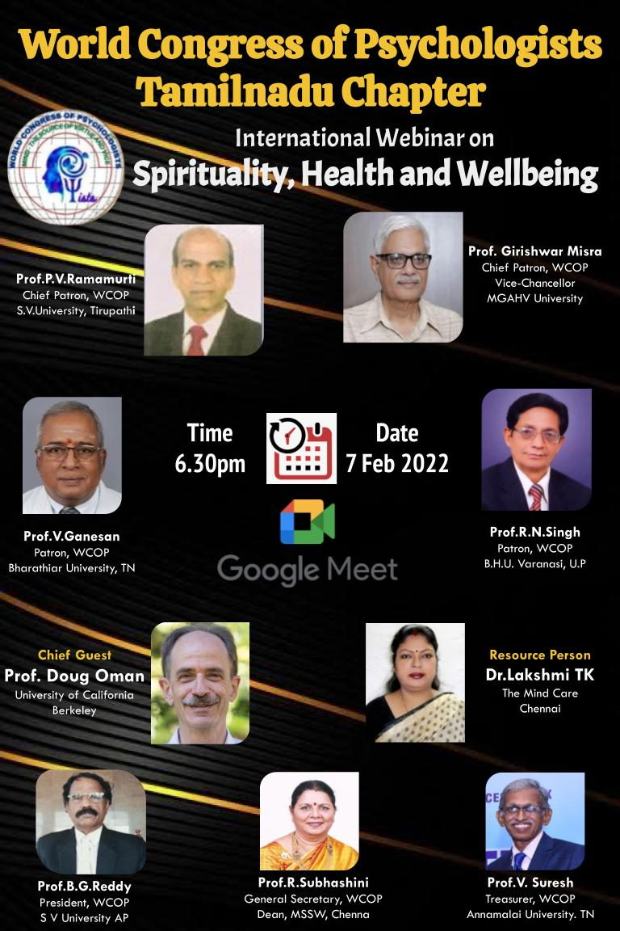
(webinar information)

