Slide 1
Spirituality and Religion:
Contributions and Implications for Well-Being and
Sustainable Development Goals
An Address at the Tenth Annual
United Nations Psychology Day (2017)
:
Headquarters of the United Nations, New York, USA
(Conference Room 4)
April 20, 2017
Presenter
:
Doug Oman, Ph.D.
School of Public Health
University of California, Berkeley
dougoman@berkeley.edu
Slides posted on “Talks” tab at: http://dougoman.org
Notes:
PODCAST
Beginning 1:29:55 at
http://webtv.un.org/search/promoting-well-being-in-the-twenty-first-century-psychological-contributions-for-social-economic-and-environmental-challenges/5406248224001?term=spiritual
PROGRAM
https://www.unpsychologyday.com/program-2017/

Slide 2
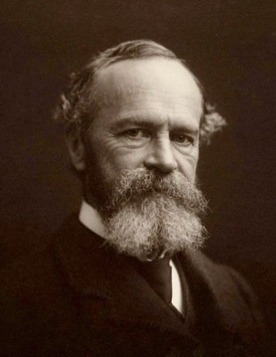
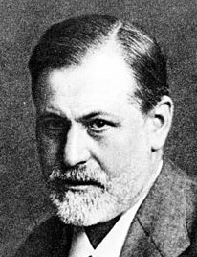



Rise, Fall, & Rise of R/S in Psychology
1.
1902 William James:
Varieties of Religious Experience
       Universal approach, Healthy + unhealthy
1907 Freud denigrated religion as a
“universal obsessional neurosis”
1913- Behaviorism & decline of interest in R/S…
2017
 20+ APA-published books on R/S
 2-volume APA Handbook on R/S
vol. 2 is “Applied Science”
 2 APA-published journals on R/S
2009-
2013 (2 vol.)
2014-
Notes:
in each slide's NOTES section (including this slide), the following preface to each reference indicates its availability:
*** = an electronic document IS AVAILABLE
** = reference is also mentioned in a different slide, under which number the electronic document is listed
* = reference only, no accompanying electronic document
*James, W. (1902/1961). The Varieties of Religious Experience: A Study in Human Nature. New York: Collier.
*Freud quote from: Freud, S. (1989). Obsessive Actions and Religious Practices (originally published 1907). In P. Gay (Ed.), The Freud reader (pp. 429-436). New York:
*Pargament, K.I. (2013). APA handbook of psychology, religion, and spirituality (2 vol.) (vol. 1: Context, theory, and research; vol. 2: An applied psychology of religion and spirituality). Washington, DC: American Psychological Association.
W.W. Norton.
Vol 1: KI Pargament, JJ Exline, & JW Jones (Eds.), APA handbook of psychology, religion, and spirituality: Vol. 1: Context, theory, and research. Washington, DC: American Psychological Association.
Vol 2: KI Pargament, A Mahoney, & EP Shafranske (Eds.), APA handbook of psychology, religion, and spirituality: Vol. 2: An applied psychology of religion and spirituality. Washington, DC: American Psychological Association.
*Psychology of Religion and Spirituality (journal 2009-present; editor: Ralph Piedmont)
*Spirituality in Clinical Practice (journal 2014-present; editors: Lisa Miller, Len Sperry)

Slide 3
What Happened?
      Unlike Freud,
      people examined…
Empirical evidence

Slide 4
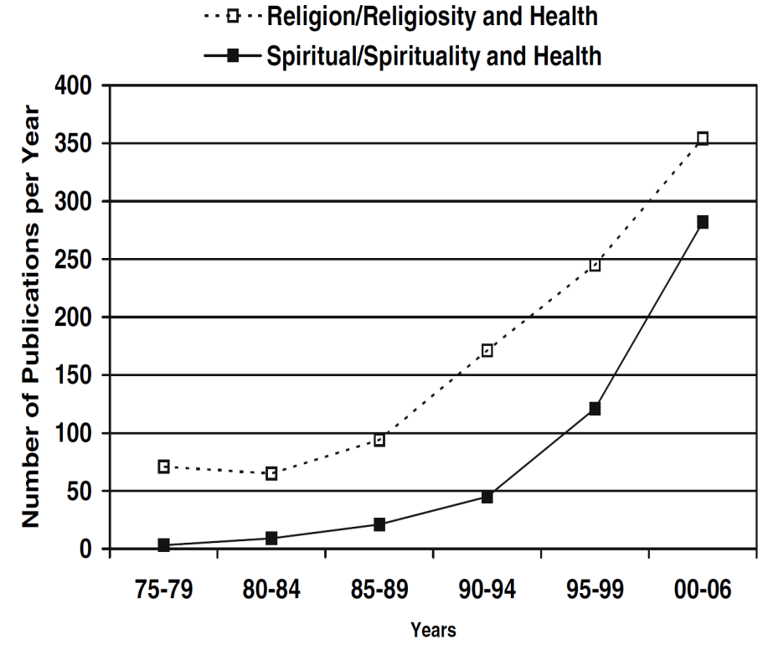
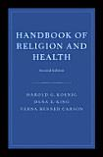
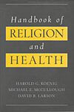
Increased Empirical Study of R/S-Health
1.
R/S-health empirical literature:
1200+ studies in 20th century
2000+ additional studies
from 2000 to 2009
 118 systematic reviews
(33 meta-analyses)
Why Religion & Spirituality Matter for Public Health: Evidence, Implications, and Resources
Doug Oman (ed.)
Koenig et al (2001).
Handbook of Religion and Health.
Oxford University Press.
Koenig et al (2012),
second edition (Oxford)
Oman (2017), forthcoming (Springer)
Notes:
***Figure from Masters, K.S. (2007). Religiosity/spirituality and behavioral medicine: Investigations concerning the integration of spirit with body. Journal of Behavioral Medicine, 30(4), 287-289, doi:10.1007/s10865-007-9116-5.
*Koenig, H.G., McCullough, M.E., & Larson, D.B. (2001). Handbook of religion and health. New York: Oxford University Press.
*Koenig, H.G., King, D.E., & Carson, V.B. (2012). Handbook of religion and health (2nd ed.). Oxford ; New York: Oxford University Press.
*Oman, D. (Ed.). (2017, forthcoming}). Why religion and spirituality matter for public health: Evidence, implications, and resources. Springer.

Slide 5
Rediscovery of R/S-Health:
Major Findings
1.
☺
Religion and Spirituality (R/S) are mostly associated with better physical & mental health
R/S (some dimensions) have at times been associated with worse health:
  Extreme R/S beliefs (e.g., refuse medical care)
  R/S “struggles”
  (persistent conflicts related to R/S)
😐

Slide 6
Sample Findings: Health Outcomes from Meta-Analyses
1.
Hummer &c (1999), N>20,000
+7 years US adults
≈ Heavy smoking (RH)
+14 years African Americans
Physical Health
R/S (mostly western samples)
⬄ longevity (18% less risk of death, HR=0.82, p <0.001)
k_{MA}=36 (Chida et al, 2009)
    ⬄ lower rates of cardiovascular diseases, cancer,
    pulmonary disease, dementia, and disability
    (Koenig et al, 2012)
Mental Health
R/S  less depression
k_{MA}=147 (Smith &c, 2003)
R/S  better mental health
k_{MA}=35 (Hackney &c, 2003)
R/S-accommodative therapies outperform both
no-treatment controls (d=.45) &
alternate secular therapies (d=.26)
(Worthington &c, 2011)
Notes:
***Chida, Y., Steptoe, A., & Powell, L.H. (2009). Religiosity/spirituality and mortality. Psychotherapy and Psychosomatics, 78(2), 81-90, doi:10.1159/000190791.
***Hummer, R.A., Rogers, R.G., Nam, C.B., & Ellison, C.G. (1999). Religious involvement and U.S. Adult mortality. Demography, 36(2), 273-285, doi:10.2307/2648114.
**Koenig et al (2012)
***Smith, T.B., McCullough, M.E., & Poll, J. (2003). Religiousness and depression: Evidence for a main effect and the moderating influence of stressful life events. Psychological Bulletin, 129(4), 614-636, doi:10.1037/0033-2909.129.4.614.
***Hackney, C. H., & Sanders, G. S. (2003). Religiosity and mental health: A meta-analysis of recent studies. Journal for the Scientific Study of Religion, 42(1), 43-55.
***Worthington, E.L., Hook, J.N., Davis, D.E., & McDaniel, M.A. (2011). Religion and spirituality. Journal of Clinical Psychology, 67(2), 204-214, doi:10.1002/jclp.20760
R/S-accommodative therapies
outperformed both
no-treatment controls
(d=.45 in k_{MA} = 22 studies) &
alternate secular psychotherapies
(d=.26 in k_{MA} = 29),
but not dismantling designs
(d=.13, ns, in k_{MA} = 11).

Slide 7
1.
Pathways: How might R/S affect health?
(what “mechanisms”?)
⇨
⇨
⇨
Physical
Health
Spirituality & Religion
R/S Coping
R/S Meditation
Mental Health
/ Character Strengths
 reduced stress

(“allostatic load”)
Moderated by Sociocultural CONTEXT
(Koenig, Larson & McCullough, 2001)
(Oman & Thoresen, 2002, 2007)
Notes:
*Koenig, H. G., McCullough, M. E., & Larson, D. B. (2001). Handbook of Religion and Health. New York: Oxford University Press.
***Oman, D., & Thoresen, C. E. (2002). "Does Religion Cause Health?": Differing Interpretations and Diverse Meanings. Journal of Health Psychology, 7(4), 365-380. doi:10.1177/1359105302007004326
***[a simplified form of the 2002 publication by the same authors:] Oman, D., & Thoresen, C. E. (2007). Does Religion Cause Health? In A. Eisen & G. Laderman (Eds.), Science, religion, and society: An encyclopedia of history, culture, and controversy (Vol. 2, pp. 685-695). Armonk, NY: ME Sharpe.

Slide 8
Sample Findings: Pathways from Meta-Analyses
1.
Health Behaviors
R/S  less youth risk behavior
k_{MA}=75 (Yonker &c, 2012)
R/S  less youth substance abuse
k_{MA}=22 (Yeung &c, 2009)
Social Connections
R/S marital stability
k_{MA}=94 (Mahoney &c, 2001)
Religious/Spiritual Coping
R/S coping  better adjustment
k_{MA}=49 (Ano & Vasconcelles, 2005)
Notes:
***Yonker, J. E., Schnabelrauch, C. A., & DeHaan, L. G. (2012). The relationship between spirituality and religiosity on psychological outcomes in adolescents and emerging adults: A meta-analytic review. Journal of Adolescence, 35(2), 299-314. doi:10.1016/j.adolescence.2011.08.010
***Yeung, J.W.K., Chan, Y.-C., & Lee, B.L.K. (2009). Youth religiosity and substance use: A meta-analysis from 1995 to 2007. Psychological Reports, 105(1), 255-266, doi:10.2466/PR0.105.1.255-266.
***Mahoney, A., Pargament, K. I., Tarakeshwar, N., & Swank, A. B. (2001). Religion in the home in the 1980s and 1990s: A meta-analytic review and conceptual analysis of links between religion, marriage, and parenting. Journal of Family Psychology, 15(4), 559-596.
***Ano, G.G., & Vasconcelles, E.B. (2005). Religious coping and psychological adjustment to stress: A meta-analysis. Journal of Clinical Psychology, 61(4), 461-480, doi:10.1002/jclp.20049.

Slide 9
Many Empirical Studies are Based in USA
2.
So is there…
Cross-Cultural Corroboration?

Slide 10
Cross-Cultural Corroboration: Sites
2.
R/S ↔ smoking*? | Poland, Central America, Mexico, Iran, Israel, Lebanon, South Africa
R/S ↔ alcohol*? | Australia, Finland, Hungary, Poland, Spain, United Kingdom, Brazil, the Caribbean, Central America, Mexico, Israel, Lebanon, Thailand, Turkey, South Africa
R/S ↔ risky sexual activity*? | Australia, Slovakia, the Caribbean, Iran, Israel, Kenya, Malawi, Nigeria
R/S ↔ depression*? | Netherlands, Yugoslavia, Mexico, Iran, Israel, Palestine, Afghanistan, Taiwan
R/S ↔ anxiety*? | Germany, Israel, Afghanistan, Japan, Sri Lanka
R/S ↔ adult well-being? | Uruguay, Kuwait, India, Malaysia, Pakistan, 140+ worldwide
R/S ↔ youth well-being? | Australia, Ukraine, United Kingdom, India, Thailand, Cameroon
R/S ↔ hypertension*? | Greece, Italy, Netherlands, United Kingdom, West Indies, Egypt, Israel, Kuwait, Turkey, India, Japan, Taiwan, Thailand, South Africa
R/S ↔ self-rated health? | Bosnia, Denmark, Finland, Italy, Poland, Scotland, Caribbean, Latin America, Mexico, Israel, Taiwan
*reduced
Notes:
Oman, D. (Ed.). (2017). Why religion and spirituality matter for public health: Evidence, implications, and resources (forthcoming): Springer.
DERIVED FROM
*Koenig, H.G., McCullough, M.E., & Larson, D.B. (2001). Handbook of religion and health. New York: Oxford University Press.
*Koenig, H.G., King, D.E., & Carson, V.B. (2012). Handbook of religion and health (2nd ed.). Oxford ; New York: Oxford University Press.

Slide 11
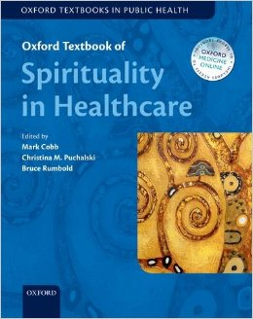
Implications for Practice
(Generic)
3.
___USA___
  Clinicians can proactively support and acknowledge
  R/S as coping resource
    Mental healthcare
    Medical care
    Accrediting Organizations
    (The Joint Commission ≈ JCAHO)
Competencies (Vieten &c, 2016)
APA books
R/S accommodative Txs
Spiritual histories
Structured protocols to talk
(Kristeller &c, 2005)
Require capacity to assess R/S
Require assessments on intake
Focus + editors:
UK, Australia, USA
Oxford Textbook of Spirituality in Healthcare
(Cobb &c, 2012)
INTERNATIONAL
Apply similar principles
Notes:
***Vieten, C., Scammell, S., Pierce, A., Pilato, R., Ammondson, I., Pargament, K.I., et al. (2016). Competencies for psychologists in the domains of religion and spirituality. Spirituality in Clinical Practice, 3(2), 92-114, doi:10.1037/scp0000078.
***Kristeller, J.L., Rhodes, M., Cripe, L.D., & Sheets, V. (2005). Oncologist assisted spiritual intervention study (OASIS): Patient acceptability and initial evidence of effects. International Journal of Psychiatry in Medicine, 35(4), 329-347.
*Cobb, M., Puchalski, C.M., & Rumbold, B. (Eds.). (2012). Oxford textbook of spirituality in healthcare. New York, NY: Oxford University Press.

Slide 12

Implications for Practice
(Generic)
3.
___USA___
  Encourage or Teach Evidence-Supported R/S Practices
  (w/o endorsing R/S beliefs)
    Meditation (sitting)
    (both spiritual, secular)
    Mantram or holy name
    repetition (“portable”)
    ⇨at Veterans Administration
Diverse methods + benefits
(Oman, 2010;
Sedlmeier &c, 2012)
Spiritual added value possible
(Wachholtz &c, 2008)
Supports/activates R/S coping
Mental health benefits
(Bormann &c, 2007, 2012)
Portable 
usable with little leisure (poor)
INTERNATIONAL
Similar
Meditation in all
major R/S traditions
(Goleman, 1988; Plante, 2010)
Cross-culturally widespread
“Ramanama”
(health program for masses)
Notes:
***Oman, D. (2010). Similarity in diversity? Four shared functions of integrative contemplative practice systems. In TG Plante (Ed.), Contemplative practices in action: Spirituality, meditation, and health [{foreword}] (pp. 7-16). Santa Barbara, CA: Praeger.
***Sedlmeier, P., Eberth, J., Schwarz, M., Zimmermann, D., Haarig, F., Jaeger, S., et al. (2012). The psychological effects of meditation: A meta-analysis. Psychological Bulletin, 138(6), 1139-1171, doi:10.1037/a0028168
***Wachholtz, A.B., & Pargament, K.I. (2008). Migraines and meditation: Does spirituality matter? Journal of Behavioral Medicine, 31(4), 351-366, doi:10.1007/s10865-008-9159-2.
***Bormann, J.E., & Oman, D. (2007). Mantram or holy name repetition: Health benefits from a portable spiritual practice. In TG Plante, & CE Thoresen (Eds.), Spirit, science and health: How the spiritual mind fuels physical wellness (pp. 94-112). Westport, CT: Praeger.
***Bormann, J.E., Thorp, S.R., Wetherell, J.L., Golshan, S., & Lang, A.J. (2013). Meditation-based mantram intervention for veterans with posttraumatic stress disorder: A randomized trial. Psychological Trauma: Theory, Research, Practice, and Policy, 5(3), 259-267, doi:10.1037/a0027522.
***Gandhi, M.K. (1949). Ramanama (2nd ed.). Ahmedabad, India: Navajivan. [see also online]
*Goleman, D. (1988). The meditative mind: The varieties of meditative experience. New York: Tarcher.
***Plante, T.G. (Ed.). (2010). Contemplative practices in action: Spirituality, meditation, and health [{foreword}]. Santa Barbara, CA: Praeger.
SEE ALSO FORTHCOMING
Farias et al (Eds.) (2018, forthcoming). Oxford Handbook of Meditation.

Slide 13

Implications:
Common Ground Strategy
3.
Support
NOT require
  Proactively support
  coping that aligns:
  insights from professional expertise
  (≈ outsider or “etic”)
  with
     spiritual traditions &/or perspectives
    (≈ insider or “emic”)
Ethical respect for R/S diversity
(+ agnostic, atheist)
Common Ground Strategy

Slide 14
Sustainable Development Goals (SDGs)?
4.
How relate to…
3. “Ensure healthy lives and promote
well-being for all at all ages.”
16. “Promote peaceful and
inclusive societies… and build effective, accountable and inclusive institutions at all levels”
Not forced to
“check your R/S identity at the door”
Common Ground Strategy
culturally inclusive

Slide 15
More International Applications?
4.
Apply common ground strategy
across diverse sectors in society?
Mental healthcare
Medical care
Public health
Natural resource management
Education
Etc.

Slide 16
Common Ground Approaches
4.
Natural Resource Management
  Task: Avoid “tragedy of commons”
  R/S role: Local cultural governance
  Research: Meta-analysis (48 studies):
Public health
  Task: Promote health of populations
  R/S functions: Ignore  Passive conduit  Active partner
  Research: USA:  cultural tailoring
  South Africa:  religious health assets
Cox et al. (2014) in World Development
  R/S performs diverse governance functions:
   regulating appropriation,  benefits,
   resource boundaries,  sanctions,
   social capital,  leadership.
Common Ground Strategy
Campbell &c (2007)
Cochrane Schmid, & Cutts (2011)
When Religion and Health Align
Notes:
***Cox, M., Villamayor-Tomas, S., & Hartberg, Y. (2014). The role of religion in community-based natural resource management. World Development, 54, 46-55, doi:10.1016/j.worlddev.2013.07.010.
***Campbell, M.K., Hudson, M.A., Resnicow, K., Blakeney, N., Paxton, A., & Baskin, M. (2007). Church-based health promotion interventions: Evidence and lessons learned. Annual Review of Public Health, 28, 213-234, doi:10.1146/annurev.publhealth.28.021406.144016.
*Cochrane, J.R., Schmid, B., & Cutts, T. (Eds.). (2011). When religion and health align: Mobilizing religious health assets for transformation. Pietermaritzburg, South Africa: Cluster Publications.

Slide 17

Role for UN?
4.
  Clearinghouse?
  Develop + disseminate professional training”
  skills for
        common ground
        ?

Slide 18
Summary
Enormous empirical base on R/S-well-being
  cross-cultural corroboration
Strategy: Build on common ground
  ideally evidence-supported
…in diverse sectors:
Mental healthcare
Medical care
Public health
Natural resource management
Education
Etc.
THANK YOU
Slides posted on “Talks” tab at: http://dougoman.org

