Slide 1
Public Health:
An Emerging Locus of Science/Religion Interaction
Doug Oman, Ph.D.
School of Public Health
University of California, Berkeley
International Network for the Study of Science and Belief in Society
(First Annual Conference)
University of Birmingham, UK
July 4, 2019
Notes:
CONFERENCE TITLE & SCHEDULE
International Network for the Study of Science and Belief in Society
Annual Conference, 2019
https://www.scienceandbeliefinsociety.org/about/engage/events/annual-conference-2019/
SESSION [PANEL 1-B: PANEL SESSION 1, PANEL B]
[Timeslot/location: Thu 4 July 14:30-16:30 (4 speakers so ~20 mins talk + 10 mins Q&A per speaker) in Elgar Room]
https://www.scienceandbeliefinsociety.org/about/engage/events/annual-conference-2019/
TITLE OF MY OWN TALK
Public Health: An Emerging Locus of Science/Religion Interaction
DESCRIPTION OF TALK
Virtually all people desire good health, a longstanding concern of both science and religion, and recurring topic of science/religion interaction. In the past two decades, many clinical health fields such as medicine and psychotherapy have directed greatly increased attention to religious and spiritual (R/S) factors in health (e.g., Koenig et al, 2001). Only recently, however, have parallel increases occurred in public health, a field dedicated to understanding the sources of the health of entire populations.
We review public health as a locus of science/religion interaction, comparing it with clinical fields. Lagging by about 20 years, scholarly/scientific books on public health now include two volumes focused on religious/spiritual factors (Idler, 2014; Oman, 2018). Yet Public Health displays all of Barbour’s classic modes of interaction (conflict, independence, dialogue, integration). In the past decade, international health organizations (e.g., WHO) have developed greater awareness of religious communities as potential allies, but such communities sometimes feel excessively instrumentalized. Surveys indicate that US public health students learn little about R/S factors in their training, and desire more knowledge. Public health school leaders (deans) are open to addressing R/S factors, but seek guidance and materials. Empirical evidence indicates that R/S factors among individuals show largely favorable relations with health, but R/S factors show mixed (favorable/unfavorable) associations with population health and its predictors. Such contrasting patterning (population versus individual) poses interpretive challenges for public health, and arguably for religious traditions and scholars of religion, beyond interpretive challenges faced in clinical fields – and interpretations arguably benefit from historicized understandings of religion. Public Health merits scholarly attention as a dynamic emerging site for science/religion interaction.
PANELISTS IN PANEL 1B
Chair (moderator): Tom Kaden
Doug Oman, University of California, Berkeley, USA
Public Health: An Emerging Locus of Science/Religion Interaction
Michael E Price, Brunel University, UK [Senior Lecturer in Psychology]
Explaining the link between religiosity and well-being: Social support versus optimism
Tom Aechtner, University of Queensland, Australia [Senior Lecturer in Religion and Science]
Improving Evolution Advocacy: Translating Vaccine Interventions to the Evolution Wars
Roxie Chuang, University of California [UCSB], USA [Graduate student in Psychology & Brain Sciences]
Religion, Social Connectedness, and Xenophobic Responses to Ebola
CONFERENCE DESCRIPTION FROM WEBSITE
In the last decade there has been significant growth in social scientific scholarship on science and religion, complementing the more established historical research into the subject. Greater attention is being paid to the varied ways in which perceptions of science are influenced by religious and non-religious belief, identity, community and conflict in different geographical, cultural and historical contexts. The purpose of this international conference is to bring together researchers with backgrounds in sociology, science and technology studies, psychology, political science, history, social anthropology, and related humanities or social science disciplines to discuss perspectives on the overarching topic of science and belief in society.
Conference themes:
The social scientific and historical study of the relationship between science and religious and/or non-religious belief and identity;
Public perceptions of the relationship between science, religion and non-religion and their respective roles in society;
National and international comparative perspectives on the study of science, religion and belief in society;
Past and present media or popular representations of science, religion and belief in society;
The past or present roles of science, rationalism, religion and belief in national, social or cultural identity and related geopolitical narratives;
Multidisciplinary and interdisciplinary approaches to the study of science, religion and non-religion in society;
Methodological approaches to, and issues in, the study of science, religion and belief in society;
Avenues for future research and developments within the social scientific and historical study of science, religion and belief in society;
Public policy research relating to any aspect of public policy that intersects with issues connected to science, religion and belief in society. Including studies on the impact of publics’ views on science and religion on policy making, and provision for religious, spiritual or non-religious communities across a range of geographies and issues (e.g. healthcare provision, educational policy, science policy, environmental policy or development);
International studies of religious or spiritual communities’ perspectives on the intersection, and possible relationships, between science and religion over time.
We are interested in papers that relate to any aspect of STEMM in society (science, technology, engineering, medicine, and mathematics) and that discuss any religious, spiritual or non-religious tradition, position or worldview, including unbelief.
Keynote papers will be given by historian Professor Peter Harrison, Australian Laureate Fellow and Director of the Institute for Advanced Studies in the Humanities at the University of Queensland (Australia), and psychologist Professor Cristine Legare, associate professor of psychology and the director of the Evolution, Variation, and Ontogeny of Learning Laboratory at The University of Texas at Austin (USA).
Should you have other questions about the conference please contact the conference co-ordinator Dr Harris Wiseman at h.wiseman@bham.ac.uk
The conference is supported by the Templeton Religion Trust and is being held as part of the activities of the newly established International Network for the Study of Science and Belief in Society, based at the University of Birmingham. For more information about the network please contact Dr Alexander Hall (A.F.Hall@bham.ac.uk).

Slide 2
OUTLINE
Interdisciplinary Background:
Religion/Spirituality (R/S) & Health
Public Health Joins the Interdisciplinary Party
Summary

Slide 3
Interdisciplinary Background

Slide 4
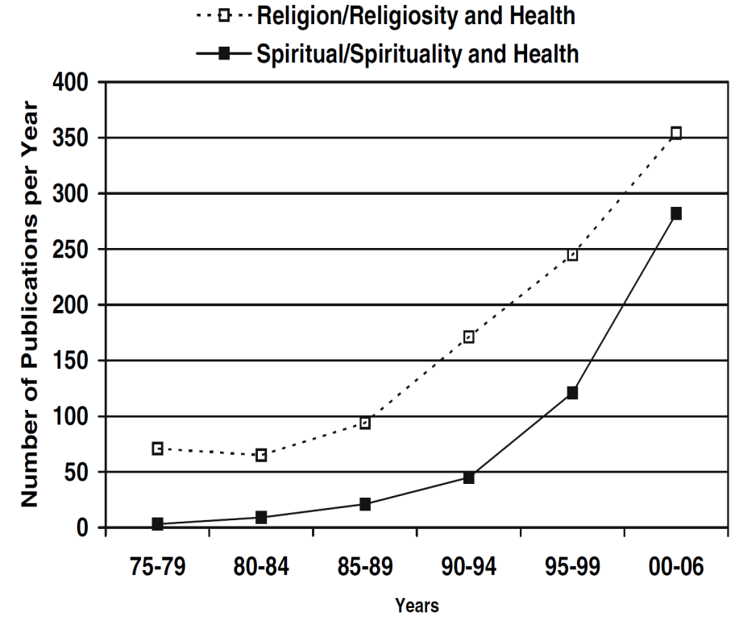
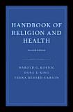
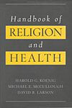
Increased Empirical Study of R/S-Health
1.
R/S-health empirical literature:
1200+ studies in 20th century
2000+ additional studies
from 2000 to 2009
 118 systematic reviews
(33 meta-analyses)
Koenig et al (2001).
Handbook of Religion and Health
Oxford University Press.
Koenig et al (2012),
second edition (Oxford)
Oman (2018)
Why R/S Matter for PH (Springer)
Notes:
***Figure from Masters, K.S. (2007). Religiosity/spirituality and behavioral medicine: Investigations concerning the integration of spirit with body. Journal of Behavioral Medicine, 30(4), 287-289, doi:10.1007/s10865-007-9116-5.
*Koenig, H.G., McCullough, M.E., & Larson, D.B. (2001). Handbook of religion and health. New York: Oxford University Press.
*Koenig, H.G., King, D.E., & Carson, V.B. (2012). Handbook of religion and health (2nd ed.). Oxford ; New York: Oxford University Press.
*Oman, D. (Ed.). (2017, forthcoming}). Why religion and spirituality matter for public health: Evidence, implications, and resources. Springer.

Slide 5
Rediscovery of R/S-Health:
Major Findings
1.
Examples…
Main finding
☺
Religion and Spirituality (R/S) in individuals are mostly associated with better physical & mental health
R/S (some dimensions) have at times been associated with worse health:
  Extreme R/S beliefs (e.g., refuse medical care)
  R/S “struggles”
  (persistent conflicts related to R/S)
Not monolithic
😐

Slide 6
Sample Findings: Health Outcomes from Meta-Analyses
1.
Hummer &c (1999), N>20,000
+7 years US adults
≈ Heavy smoking (RH)
+14 years African Americans
Physical Health
R/S [mostly western samples]
⬄ longevity (18% less risk of death, HR=0.82, p <0.001)
k_{MA}=36 (Chida et al, 2009)
    ⬄ lower rates of cardiovascular diseases, cancer,
    pulmonary disease, dementia, and disability
    (Koenig et al, 2012)
Mental Health
R/S  less depression
k_{MA}=147 (Smith &c, 2003)
R/S  better mental health
k_{MA}=35 (Hackney &c, 2003)
R/S-accommodative therapies outperform both
no-treatment controls (d=.45) &
alternate secular therapies (d=.26)
(Worthington &c, 2011)
Notes:
***Chida, Y., Steptoe, A., & Powell, L.H. (2009). Religiosity/spirituality and mortality. Psychotherapy and Psychosomatics, 78(2), 81-90, doi:10.1159/000190791.
***Hummer, R.A., Rogers, R.G., Nam, C.B., & Ellison, C.G. (1999). Religious involvement and U.S. Adult mortality. Demography, 36(2), 273-285, doi:10.2307/2648114.
**Koenig et al (2012)
***Smith, T.B., McCullough, M.E., & Poll, J. (2003). Religiousness and depression: Evidence for a main effect and the moderating influence of stressful life events. Psychological Bulletin, 129(4), 614-636, doi:10.1037/0033-2909.129.4.614.
***Hackney, C. H., & Sanders, G. S. (2003). Religiosity and mental health: A meta-analysis of recent studies. Journal for the Scientific Study of Religion, 42(1), 43-55.
***Worthington, E.L., Hook, J.N., Davis, D.E., & McDaniel, M.A. (2011). Religion and spirituality. Journal of Clinical Psychology, 67(2), 204-214, doi:10.1002/jclp.20760
R/S-accommodative therapies
outperformed both
no-treatment controls
(d=.45 in k_{MA} = 22 studies) &
alternate secular psychotherapies
(d=.26 in k_{MA} = 29),
but not dismantling designs
(d=.13, ns, in k_{MA} = 11).

Slide 7
Generic Model of Individual Effects
Conceptualizing R/S community-level effects
Health Behaviors
Physical Health & Longevity
Individual
Religion / Spirituality
Beliefs
Practices
R/S coping
Social Connections
Mental Health & Character Strengths
Notes:
Oman, D. (2018). Model of individual health effects from religion/spirituality: Supporting evidence. In D. Oman (Ed.), Why religion and spirituality matter for public health: Evidence, implications, and resources (pp. 27-63). Cham, Switzerland: Springer International. https://doi.org/10.1007/978-3-319-73966-3_3

Slide 8
Generic Model of Individual Effects
Conceptualizing R/S community-level effects
Health Behaviors
Physical Health & Longevity
Individual
Religion / Spirituality
Beliefs
Practices
R/S coping
+ -
Host Resis-tance
Immune
Endocrine
Cardio-
vascular
+
-
Social Connections
+ -
Mental Health & Character Strengths
Bio-psycho-social, health, demographic, & cultural, context

Slide 9

What do we mean by
R/S-Science Interaction?
Religion Science
Health Sciences
Goal = Beneficial Action
Informed by beliefs,
but goal ≠ agreement

Goal = Correct Beliefs
(Barbour’s typology)
Barbour (2000):
“My [4-fold] typology was developed for fundamental science as a form of knowledge,
not for applied science…”
Barbour’s 4-fold typology:
Conflict
Independence
Dialogue
Integration
Notes:
Barbour, I. G. (1990). Religion in an age of science. San Francisco: Harper & Row. [perhaps first published in 1988 by HarperCollins]
Chapter 1 (contains fourfold typology):
https://www.religion-online.org/book-chapter/chapter-1-ways-of-relating-science-and-religion/
Barbour, I. G. (2000). When science meets religion. San Francisco: HarperSanFrancisco.
“My typology was developed for fundamental science as a form of knowledge,
not for applied science in its impact on society and nature” (p. 4)

Slide 10
What do we mean by
R/S-Science Interaction?
Religion Science
Health Sciences
Goal = Beneficial Action
Informed by beliefs,
but goal ≠ agreement

Many Examples
Stem cells
Reproductive issues
Contra-indicated customs
Etc.
Action focus of health professions:
Interactions of R/S-science might include
Conflict over goals or methods
Collaboration on fully or partly shared goals
Developing theories to guide collaboration

Slide 11
How do Science and Religion Interact in
Clinical Care?
One small slice of public health

Slide 12
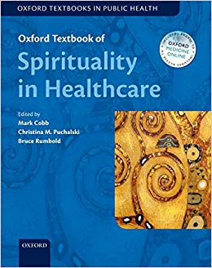
#1: Building Individual Clinical Care Alliance
(provider/patient)
Locus #1
2. Collaboration on fully or partly shared goals
Clinical Treatment in Medicine & Psychology
Proactively respect patient R/S
Books
Oxford Textbook of Spirituality in Healthcare (Cobb, Puchalski & Rumbold, 2012)
Notes:
Cobb, M., Puchalski, C. M., & Rumbold, B. (Eds.). (2012). Oxford textbook of spirituality in healthcare. New York, NY: Oxford University Press.

Slide 13
#1: Building Individual Clinical Care Alliance
(provider/patient)
Locus #1
2. Collaboration on fully or partly shared goals
Clinical Treatment in Medicine & Psychology
Proactively respect patient R/S
Assess R/S for accreditation (JCAHO/TJC)
Spiritual Assessment Tools
Koenig (2000)
Religion, spirituality and medicine: Application to clinical practice
JAMA 284, 1708
Many others
Notes:
Koenig, H. G. (2000). Religion, spirituality, and medicine: Application to clinical practice. Journal of the American Medical Association, 284, 1708. https://doi.org/10.1001/jama.284.13.1708-JMS1004-5-1

Slide 14
#1: Building Individual Clinical Care Alliance
(provider/patient)
Locus #1
2. Collaboration on fully or partly shared goals
Clinical Treatment in Medicine & Psychology
Proactively respect patient R/S
Assess R/S for accreditation (JCAHO/TJC)
Refer when appropriate to chaplains
Boundaries & Resources
Post, Puchalski, & Larson (2000). Physicians and patient spirituality: Professional boundaries, competency, and ethics. Annals of Internal Medicine, 132, 578-583.
Notes:
Post, S. G., Puchalski, C. M., & Larson, D. B. (2000). Physicians and patient spirituality: Professional boundaries, competency, and ethics. Annals of Internal Medicine, 132, 578-583. https://doi.org/10.7326/0003-4819-132-7-200004040-00010

Slide 15
#1: Building Individual Clinical Care Alliance
(provider/patient)
Locus #1
2. Collaboration on fully or partly shared goals
Clinical Treatment in Medicine & Psychology
Proactively respect patient R/S
Assess R/S for accreditation (JCAHO/TJC)
Refer when appropriate to chaplains
Support use of positive R/S coping + resources
Psych.: Therapeutic alliance
Medicine: Medical alliance
Skills
Zinnbauer & Pargament (2000)
Working with the sacred: Four approaches to religious and spiritual issues in counseling.
Journal of Counseling & Development, 78, 162-171
Alliance Goals
Verhulst, Kramer et al (2013)
Narrative concordance
Relational concordance
Notes:
Zinnbauer, B. J., & Pargament, K. I. (2000). Working with the sacred: Four approaches to religious and spiritual issues in counseling. Journal of Counseling & Development, 78, 162-171. https://doi.org/10.1002/j.1556-6676.2000.tb02574.x
Verhulst, J., Kramer, D., Swann, A. C., Hale-Richlen, B., & Beahrs, J. (2013). The medical alliance: From placebo response to alliance effect. The Journal of Nervous and Mental Disease, 201, 546-552. https://doi.org/10.1097/NMD.0b013e31829829e1

Slide 16
2. Public Health
Joins the Party

Slide 17
What is Public Health?
Common definition:
  “Public health is the science and art of preventing disease, prolonging life and promoting health through organized efforts and informed choices of society, organizations, public and private, communities and individuals”
-- Association of Schools and
Programs of Public Health (2016)
Notes:
ASPPH. (2016). Academic public health's priorities for America: Advancing public health education, science and practice as the basis for improving population health. Washington, DC: Association of Schools and Programs of Public Health (https://www.aspph.org/connect/#fact-sheets, accessed 25 May, 2019).
Winslow, C.-E. A. (1920). The untilled fields of public health. Science, 51, 23-33. https://doi.org/10.1126/science.51.1306.23
The ASPPH definition may be viewed as a modernized rendering of Winslow’s (1920) definition that “Public health is the science and the art of preventing disease, prolonging life, and promoting physical health and efficiency through organized community efforts for the sanitation of the environment, the control of community infections, the education of the individual in principles of personal hygiene, the organization of medical and nursing service for the early diagnosis and preventive treatment of disease, and the development of the social machinery which will ensure to every individual in the community a standard of living adequate for the maintenance of health” (p. 30).

Slide 18
Some Distinctive* Emphases of Public Health:
Population and Prevention
How can we reduce rates of illness in the whole population?
Can we intervene “upstream” to prevent illness?
How is population health affected by social environments and sociocultural factors?
*Distinctive ≠ exclusive

Slide 19
Public Health
Distinctive* Foci & Loci for Interaction
*Distinctive ≠ exclusive

Slide 20
Potential
Foci & Loci of Interaction of R/S and Health Professions
 |  | Focus (Activity)
 |  | Treatment | Promotion/ Prevention | Research
Locus | Individual
 | Group
 | Society
 | Policy

Slide 21
Potential
Foci & Loci of Interaction of R/S and Health Professions
 |  | Focus (Activity)
 |  | Treatment | Promotion/ Prevention | Research
Locus | Individual
 | Group
 | Society
 | Policy
Clinical treatment (Medicine, Psychology)
Individual predictors
Bulk of previous work on implications of R/S for practice

Slide 22
Potential
Foci & Loci of Interaction of R/S and Health Professions
Conflict
Possible everywhere, Required nowhere
 |  | Focus (Activity)
 |  | Treatment | Promotion/ Prevention | Research
Locus | Individual
 | Group
 | Society
 | Policy
Clinical treatment (Medicine, Psychology)
Public health research
Public health practice: everywhere (especially here)
“preventing disease … promoting health through organized efforts… of society, organizations… communities and individuals…”

Slide 23
Example of Science & Religion Interaction in
Public Health

Slide 24
#2: Building Organizational Alliances
(healthcare/religion)
Locus #2 (PH)
2. Collaboration on fully or partly shared goals
 |  | Focus (Activity)
 |  | Treatment | Promotion/ Prevention | Research
Locus | Individual
 | Group
 | Society
 | Policy
Art & Science of Faith-Health Partnering
Local, municipal
International (World Health Organization &c)
Cultural tailoring
Reaching hard-to-reach populations
Public health practice: everywhere (especially here)
Organizational collaboration?
#2
Notes:
Verhulst, J., Kramer, D., Swann, A. C., Hale-Richlen, B., & Beahrs, J. (2013). The medical alliance: From placebo response to alliance effect. The Journal of Nervous and Mental Disease, 201, 546-552. https://doi.org/10.1097/NMD.0b013e31829829e1

Slide 25
#2: Building Organizational Alliances
(healthcare/religion)
Locus #2 (PH)
2. Collaboration on fully or partly shared goals
Art & Science of Faith-Health Partnering
Local, municipal
International (World Health Organization &c)
Cultural tailoring
Reaching hard-to-reach populations
Public health practice: everywhere
Notes:
Verhulst, J., Kramer, D., Swann, A. C., Hale-Richlen, B., & Beahrs, J. (2013). The medical alliance: From placebo response to alliance effect. The Journal of Nervous and Mental Disease, 201, 546-552. https://doi.org/10.1097/NMD.0b013e31829829e1

Slide 26

#2: Building Organizational Alliances
(healthcare/religion)
Locus #2 (PH)
2. Collaboration on fully or partly shared goals
Art & Science of Faith-Health Partnering
Local, municipal
International (World Health Organization &c)
Cultural tailoring
Reaching hard-to-reach populations
Public health practice: everywhere
Innovative Collaboration
Shields et al (2016) on mutual referral arrangements in India
Skills
Annual Review of Public Health
Campbell &c (2007). Church-based health promotion interventions.
Why Religion & Spirituality Matter for Public Health (2018)
Epstein on Community Health Practitioners
Cutts & Gunderson on Public Health Systems+Congregations
Grant &c on International Organizations (WHO, etc.)
Books
Why Religion and Spirituality Matter in Public Health (Oman, 2018)
Books
It is Well with My Soul (Tuggle, 2000)
Notes:
Campbell, M. K., Hudson, M. A., Resnicow, K., Blakeney, N., Paxton, A., & Baskin, M. (2007). Church-based health promotion interventions: Evidence and lessons learned. Annual Review of Public Health, 28, 213-234. https://doi.org/10.1146/annurev.publhealth.28.021406.144016
Epstein, N. E. (2018). Implications for community health practitioners: Framing religion and spirituality within a social ecological framework. In D. Oman (Ed.), Why religion and spirituality matter for public health: Evidence, implications, and resources (pp. 305-322). Cham, Switzerland: Springer International. https://doi.org/10.1007/978-3-319-73966-3_17
Cutts, T. F., & Gunderson, G. R. (2018). Implications for public health systems and clinical practitioners: Strengths of congregations, religious health assets and leading causes of life. In D. Oman (Ed.), Why religion and spirituality matter for public health: Evidence, implications, and resources (pp. 323-340). Cham, Switzerland: Springer International. https://doi.org/10.1007/978-3-319-73966-3_18
Grant, L., & Oman, D. (2018). International and global perspectives on spirituality, religion, and public health. In D. Oman (Ed.), Why religion and spirituality matter for public health: Evidence, implications, and resources (pp. 447-462). Cham, Switzerland: Springer International. https://doi.org/10.1007/978-3-319-73966-3_27
Shields, L., Chauhan, A., Bakre, R., Hamlai, M., Lynch, D., & Bunders, J. (2016). How can mental health and faith-based practitioners work together? A case study of collaborative mental health in Gujarat, India. Transcultural Psychiatry, 53, 368-391. 10.1177/1363461516649835
Verhulst, J., Kramer, D., Swann, A. C., Hale-Richlen, B., & Beahrs, J. (2013). The medical alliance: From placebo response to alliance effect. The Journal of Nervous and Mental Disease, 201, 546-552. https://doi.org/10.1097/NMD.0b013e31829829e1

Slide 27
Surveys: PH Openness to R/S
US National
(2013)
Are PH grad students open?
+ How frequently is R/S-health covered?
+ What topics merit coverage?
+ What predicts student openness?
Are PH deans open?
From Oman (2018). “Introduction: What should public health students be taught about religion and spirituality?” In Part III, Why Religion/Spirituality Matters…
Notes:
Oman, D. (2018). Introduction: What should public health students be taught about religion and spirituality? In D. Oman (Ed.), Why religion and spirituality matter for public health: Evidence, implications, and resources (pp. 343-355). Cham, Switzerland: Springer International. https://doi.org/10.1007/978-3-319-73966-3_19

Slide 28
Are Graduate Students Open?
Grad students in 24 US Schools/Colleges of PH
(out of ~50 total in US)
Majority wants more coverage
(surveys conducted in 2013)

Slide 29
How frequently is R/S-health covered?
PH grad students (N=980)
Some coverage, much neglect

Slide 30
What Topics Merit Coverage?
PH grad students (N=980)
Most R/S topics merit coverage
“similar to other health factors”

Slide 31
Training Implications: Overall
PH grad students (N=980)
The more students learn,
the more students want “equal” coverage
Familiarity breeds interest

Slide 32
Are PH School Leaders Open?
School leaders (e.g., deans) of 24 US Schools/Colleges of PH
(out of ~50 total in US)
Majority wants coverage of evidence
(surveys conducted in 2013)

Slide 33
How Science & Religion
Interact in
Public Health:
  Two More Examples

Slide 34
Locus #3:
Tension:
Collective Level (±) vs
Individual Level (+)

Slide 35
#3: Is R/S Linked Coherently to Health?
Locus #3
3. Developing theories to guide collaboration
 |  | Focus (Activity)
 |  | Treatment | Promotion/ Prevention | Research
Locus | Individual
 | Group
 | Society
 | Policy
☺
R/S  + BETTER individual health [usually]
😐
R/S  ± collective health factors,
MIXED better/worse
R/S  ± discrimination  worse collective health
New Phenomenon
Individual vs Collective Paradox
How explain?
Implications for practice?

Slide 36

#3: Is R/S Linked Coherently to Health?
Locus #3
3. Developing theories to guide collaboration
New Phenomenon
Why are R/S associated so favorably with individual health, but so ambivalently with group health factors?
Individual vs Collective Paradox
How explain?
Implications for practice?
Oman & Nuru-Jeter (2018, p. 113) suggest:
Most/all religious traditions sanctify
overarching virtues such as justice
Traditions also sanctify religious means, such as codes or norms of behavior aimed to help enact those virtues
Changes in sociocultural conditions may
render sanctified codes misaligned w/ virtue
in traditions that respond slowly or poorly
(Peterson & Seligman, Oxford & APA, 2004)
(e.g., 19th C. conflicts over slavery)
Minimalist… but how test? What assumptions?
Outdated or maladapted codes  worse collective health
Notes:
Oman, D., & Nuru-Jeter, A. M. (2018). Social identity and discrimination in religious/spiritual influences on health. In D. Oman (Ed.), Why religion and spirituality matter for public health: Evidence, implications, and resources (pp. 111-137). Cham, Switzerland: Springer International. https://doi.org/10.1007/978-3-319-73966-3_6
*See especially p. 113.
Cites:
Oman, D., & Syme, S. L. (2018). Social and community-level factors in health effects from religion/spirituality. In D. Oman (Ed.), Why religion and spirituality matter for public health: Evidence, implications, and resources (pp. 81-110). Cham, Switzerland: Springer Nature. https://doi.org/10.1007/978-3-319-73966-3_5
*See especially section 1, “A Dynamic and Evolving Conception”, pp. 84-86.
Peterson, C., & Seligman, M. E. P. (2004). Character strengths and virtues: A handbook and classification. Washington, DC and New York: American Psychological Association and Oxford University Press.

Slide 37
#3: Is R/S Linked Coherently to Health?
Locus #3
3. Developing theories to guide collaboration
New Phenomenon
Why are R/S associated so favorably with individual health, but so ambivalently with group health factors?
Individual vs Collective Paradox
How explain?
Implications for practice?
Oman & Nuru-Jeter (2018, p. 113) suggest:
Most/all religious traditions sanctify
overarching virtues such as justice
Traditions also sanctify religious means, such as codes or norms of behavior aimed to help enact those virtues
Changes in sociocultural conditions may
render sanctified codes misaligned w/ virtue
in traditions that respond slowly or poorly
Can we find fuller explanations that satisfy…
Scholars/scientists (etic)?
Both scientists (etic)
and religious (emic)?
(Peterson & Seligman, Oxford & APA, 2004)
(e.g., 19th C. conflicts over slavery)
Need a special issue?
Minimalist… but how test? What assumptions?
Outdated or maladapted codes  worse collective health
Notes:
Oman, D., & Nuru-Jeter, A. M. (2018). Social identity and discrimination in religious/spiritual influences on health. In D. Oman (Ed.), Why religion and spirituality matter for public health: Evidence, implications, and resources (pp. 111-137). Cham, Switzerland: Springer International. https://doi.org/10.1007/978-3-319-73966-3_6
*See especially p. 113.
Cites:
Oman, D., & Syme, S. L. (2018). Social and community-level factors in health effects from religion/spirituality. In D. Oman (Ed.), Why religion and spirituality matter for public health: Evidence, implications, and resources (pp. 81-110). Cham, Switzerland: Springer Nature. https://doi.org/10.1007/978-3-319-73966-3_5
*See especially section 1, “A Dynamic and Evolving Conception”, pp. 84-86.
Peterson, C., & Seligman, M. E. P. (2004). Character strengths and virtues: A handbook and classification. Washington, DC and New York: American Psychological Association and Oxford University Press.

Slide 38
#3: Is R/S Linked Coherently to Health?
Locus #3
3. Developing theories to guide collaboration
 |  | Focus (Activity)
 |  | Treatment | Promotion/ Prevention | Research
Locus | Individual
 | Group
 | Society
 | Policy
Clinical treatment
3. Developing theories
to guide collaboration
2. Collaboration on fully or partly shared goals
Public health practice: everywhere (especially here)
New Phenomenon
Societies are driven to
make shared cultural sense
of religion-health relationships

Slide 39

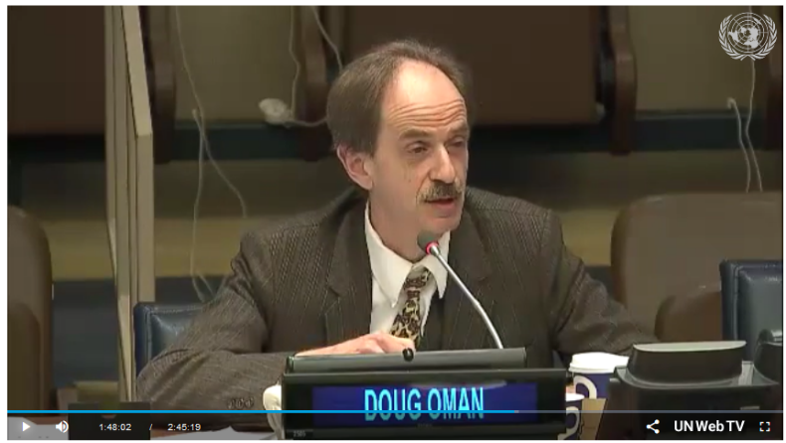
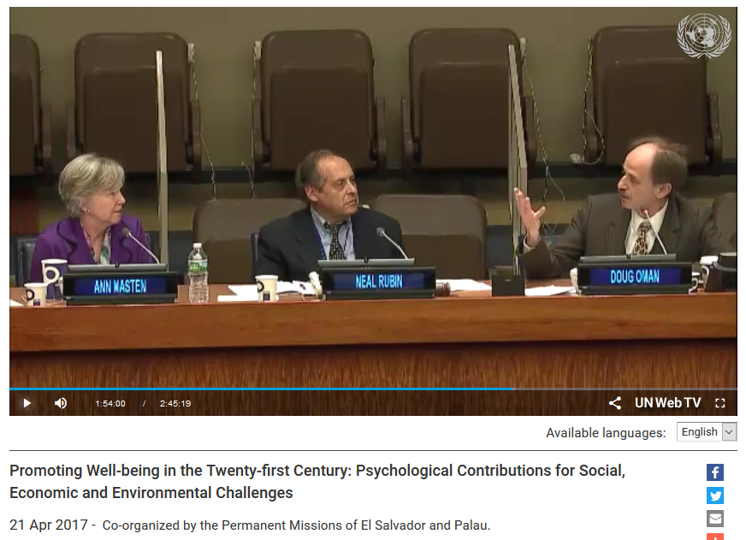
United Nations interest in R/S-public health
“Spirituality and religion: Contributions and implications
for well-being and sustainable development goals”
(Invited address, 20 April 2017)
Notes:
Doug Oman (2017). “Spirituality and religion: Contributions and implications for well-being and sustainable development goals” (Invited address at the Tenth Annual United Nations Psychology Day, Headquarters of the United Nations, New York, USA, April 20, 2017. http://webtv.un.org/search/promoting-well-being-in-the-twenty-first-century-psychological-contributions-for-social-economic-and-environmental-challenges/5406248224001?term=psychology (podcast of Oman’s talk begins at 1:29:55)

Slide 40
Locus #4:
Meditation & Mindfulness

Slide 41
#4: How are Meditation and “Mindfulness” Relevant to Health and to Religion?
Locus #4
2. Collaboration on fully or partly shared goals
 |  | Focus (Activity)
 |  | Treatment | Promotion/ Prevention | Research
Locus | Individual
 | Group
 | Society
 | Policy
Clinical treatment
3. Developing theories
to guide collaboration
2. Collaboration on fully or partly shared goals
Public health practice: everywhere (especially here)
Are meditation/“mindfulness” practices relevant to health promotion and/or healthcare?
Does “mindfulness” already exist within diverse religions?
How culturally tailor?
#4

Slide 42
#4: How are Meditation and “Mindfulness” Relevant to Health and to Religion?
Locus #4
2. Collaboration on fully or partly shared goals
Are meditation/“mindfulness” practices relevant to health promotion and/or healthcare?
Does “mindfulness” already exist within diverse religions?
How culturally tailor?
#4
Raises a few questions…

Slide 43
#4: How are Meditation and “Mindfulness” Relevant to Health and to Religion?
Locus #4
2. Collaboration on fully or partly shared goals
Are meditation/“mindfulness” practices relevant to health promotion and/or healthcare?
Does “mindfulness” already exist within diverse religions?
How culturally tailor?
#4
Assuming health is benefited…
Diversity. Should culturally tailored versions be provided, or is mindfulness meditation a one-size-fits-all practice?
Mindfulness meditation NOT preferred by a majority
  US national survey:
  7.0 million “spiritual” versus
  3.6 million “mindfulness” meditators (Burke &c, 2017)
  Experimental crossover study (Burke, 2012)
Notes:
Burke, A., Lam, C. N., Stussman, B. & Yang, H. (2017) Prevalence and patterns of use of mantra, mindfulness and spiritual meditation among adults in the United States. BMC Complementary and Alternative Medicine, 17 (1), Article 316.
Burke, A. (2012) Comparing Individual Preferences for Four Meditation Techniques: Zen, Vipassana (Mindfulness), Qigong, and Mantra. Explore: The Journal of Science and Healing, 8 (4), 237-242.

Slide 44
#4: How are Meditation and “Mindfulness” Relevant to Health and to Religion?
Locus #4
2. Collaboration on fully or partly shared goals
Are meditation/“mindfulness” practices relevant to health promotion and/or healthcare?
Does “mindfulness” already exist within diverse religions?
How culturally tailor?
#4
Assuming health is benefited…
Diversity. Should culturally tailored versions be provided, or is mindfulness meditation a one-size-fits-all practice?
Long-term benefit. Are long-term benefits truncated by secularization?
R/S-accommodative therapies outperform both
no-treatment controls (d=.45) &
alternate secular therapies (d=.26)
(Worthington &c, 2011)
Choice of spiritual meditative focus can matter
  RCTs (Wachholtz et al, 2005, 2008, 2017)
  Deep basis in traditions (Oman & Bormann, 2018)
Notes:
Worthington, E. L., Hook, J. N., Davis, D. E., & McDaniel, M. A. (2011). Religion and spirituality. Journal of Clinical Psychology, 67, 204-214. https://doi.org/10.1002/jclp.20760
Wachholtz, A. B. & Pargament, K. I. (2005) Is Spirituality a Critical Ingredient of Meditation? Comparing the Effects of Spiritual Meditation, Secular Meditation, and Relaxation on Spiritual, Psychological, Cardiac, and Pain Outcomes. Journal of Behavioral Medicine, 28 (4), 369-384.
Wachholtz, A. B. & Pargament, K. I. (2008) Migraines and meditation: does spirituality matter? Journal of Behavioral Medicine, 31 (4), 351-366.
Wachholtz, A. B., Malone, C. D. & Pargament, K. I. (2017) Effect of Different Meditation Types on Migraine Headache Medication Use. Behavioral Medicine, 43 (1), 1-8.
Oman, D. & Bormann, J. E. (2018) Eknath Easwaran's Mantram and Passage Meditation as Applied Indian Psychology: Psycho-Spiritual and Health Effects. Psychological Studies, 63 (2), 94-108.

Slide 45
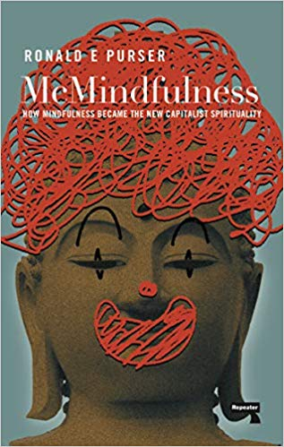
#4: How are Meditation and “Mindfulness” Relevant to Health and to Religion?
Locus #4
2. Collaboration on fully or partly shared goals
Are meditation/“mindfulness” practices relevant to health promotion and/or healthcare?
Does “mindfulness” already exist within diverse religions?
How culturally tailor?
#4
Assuming health is benefited…
Diversity. Should culturally tailored versions be provided, or is mindfulness meditation a one-size-fits-all practice?
Long-term benefit. Are long-term benefits truncated by secularization?
Socio-spiritual side-effects? Is mindfulness “stealth Buddhism”? Stealth corporatism? Stealth secularism? Colonization of the mind?
Stealth Buddhism
C. G. Brown (2016, 2017)
Discourse Analysis
Oxford Handbook of the Study of Religion
Vollmer &c (2016). Science.
[Buddhism & science as interacting discourses]
McMindfulness = New Capitalist Spirituality (Purser, 2019)
Notes:
Brown, C. G. (2016). Can “secular” mindfulness be separated from religion? In R. E. Purser, D. Forbes, & A. Burke (Eds.), Handbook of mindfulness: Culture, context, and social engagement (pp. 75-94). Cham, Switzerland: Springer International. https://doi.org/10.1007/978-3-319-44019-4_6
Brown, C. G. (2017). Ethics, transparency, and diversity in mindfulness programs. In L. M. Monteiro, J. F. Compson, & F. Musten (Eds.), Practitioner's guide to ethics and mindfulness-based interventions (pp. 45-85). Cham, Switzerland: Springer International. 10.1007/978-3-319-64924-5_3
Purser, R. (2019). Mcmindfulness: How mindfulness became the new capitalist spirituality. London, UK: Repeater.
Vollmer, L. J., & von Stuckrad, K. (2016). Science. In M. Stausberg & S. Engler (Eds.), The Oxford handbook of the study of religion (pp. 450-471). Oxford: Oxford University Press. https://doi.org/10.1093/oxfordhb/9780198729570.013.32

Slide 46
#4: How are Meditation and “Mindfulness” Relevant to Health and to Religion?
Locus #4
2. Collaboration on fully or partly shared goals
Are meditation/“mindfulness” practices relevant to health promotion and/or healthcare?
Does “mindfulness” already exist within diverse religions?
How culturally tailor?
#4
Socio-spiritual side-effects? Is mindfulness “stealth Buddhism”? Stealth corporatism? Stealth secularism? Colonization of the mind?
American Psychologist
Walsh and Shapiro (2006, p. 228):
  [What has emerged] is an assimilative integration that feeds the global “colonization of the mind” by Western psychology that “undermines the growth and credibility of other psychologies” (Marsella, 1998, p. 1286). As such, it overlooks much of the richness and uniqueness of the meditative disciplines and the valuable complementary perspectives they offer.
Notes:
Walsh, R., & Shapiro, S. L. (2006). The meeting of meditative disciplines and western psychology: A mutually enriching dialogue. American Psychologist, 61, 227-239. 10.1037/0003-066x.61.3.227

Slide 47
Summary
Public health adds new community-level and preventive emphases to studies of Religion/Spirituality (R/S) and health
In public health, R/S and science interact many ways
Public health students and leaders (in USA) are open to R/S topics, and resources are available
IN SUM: Public health is an emerging
locus of science/religion interaction
THANK YOU
DougOman@Berkeley.edu DougOman.org
Notes:
*Oman, D. (Ed.). (2018, forthcoming). Why Religion and Spirituality Matter for Public Health: Evidence, Implications, and Resources. Springer.

Slide 48
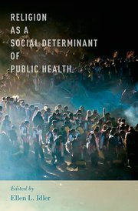
R/S and Public Health: Resources
Last 5 Years
Tuggle (2000)
American Public Health Association
Idler (ed., 2014)
Oxford Univ. Press
Oman (ed., 2018)
Springer
“How to”: Partnering w/ Religious Congregations
Evidence,
Practice, Teaching
Books on R/S and Public Health
Notes:
*Tuggle, M.B. (2000). It Is Well With My Soul: Churches and Institutions Collaborating for Public Health. Washington, DC: American Public Health Association.
*Idler, E.L. (Ed.). (2014). Religion as a Social Determinant of Public Health: Oxford University Press.
*Oman, D. (Ed.). (2018). Why religion and spirituality matter for public health: Evidence, implications, and resources. Cham, Switzerland: Springer International https://doi.org/10.1007/978-3-319-73966-3

Slide 49
#4: How are Meditation and “Mindfulness” Relevant to Health and to Religion?
Locus #4
2. Collaboration on fully or partly shared goals
Are meditation/“mindfulness” practices relevant to health promotion and/or healthcare?
Does “mindfulness” already exist within diverse religions?
How culturally tailor?
#4
First: Are they TRULY health-promotional?
Are meditation and/or mindfulness, like physical exercise, so healthy as to merit wide dissemination in schools + elsewhere as “upstream” prevention?
Visionary Advocacy
Teachers College Record
Thurman (2006). Meditation and education: India, Tibet, and modern America.
Empirical Studies
American Journal of Public Health
Fledderus &c (2010). Mental health promotion as a new goal in public mental health care: A randomized controlled trial of an [mindfulness-based] intervention enhancing psychological flexibility.
Notes:
Fledderus, M., Bohlmeijer, E. T., Smit, F., & Westerhof, G. J. (2010). Mental health promotion as a new goal in public mental health care: A randomized controlled trial of an intervention enhancing psychological flexibility. American Journal of Public Health, 100, 2372-2372. 10.2105/ajph.2010.196196
Thurman, R. A. F. (2006). Meditation and education: India, Tibet, and modern America. Teachers College Record, 108, 1765-1774.
Vollmer, L. J., & von Stuckrad, K. (2016). Science. In M. Stausberg & S. Engler (Eds.), The Oxford handbook of the study of religion (pp. 450-471). Oxford: Oxford University Press. https://doi.org/10.1093/oxfordhb/9780198729570.013.32

