Slide 1
“Does Religion Cause Health?”:
Sketching the Science for a General Audience
Presentation for the Webinar
Religion, Public Health and COVID-19:
Tips and Tools for
Teaching about Religion Remotely
Host: Public Scholars Project, a joint initiative of the Public Understanding of Religion Committee of the American Academy of Religion and the Religious Freedom Center of the Freedom Forum Institute
April 9, 2020
Presenter
:
Doug Oman, Ph.D.
School of Public Health
University of California, Berkeley
dougoman@berkeley.edu
Slides posted on “Talks” tab at: http://dougoman.org
Notes:
HOSTED BY:
Public Scholars Project, a joint initiative of the Public Understanding of Religion Committee of the American Academy of Religion and the Religious Freedom Center of the Freedom Forum Institute

Slide 2
OUTLINE
Does science say that religious or spiritual (R/S) involvement makes us healthy?
  Much evidence links R/S with individual health through well-supported pathways
    Individual R/S-health links mostly favorable
      Main frameworks are non-reductionistic & highlight commonalities across traditions

Slide 3
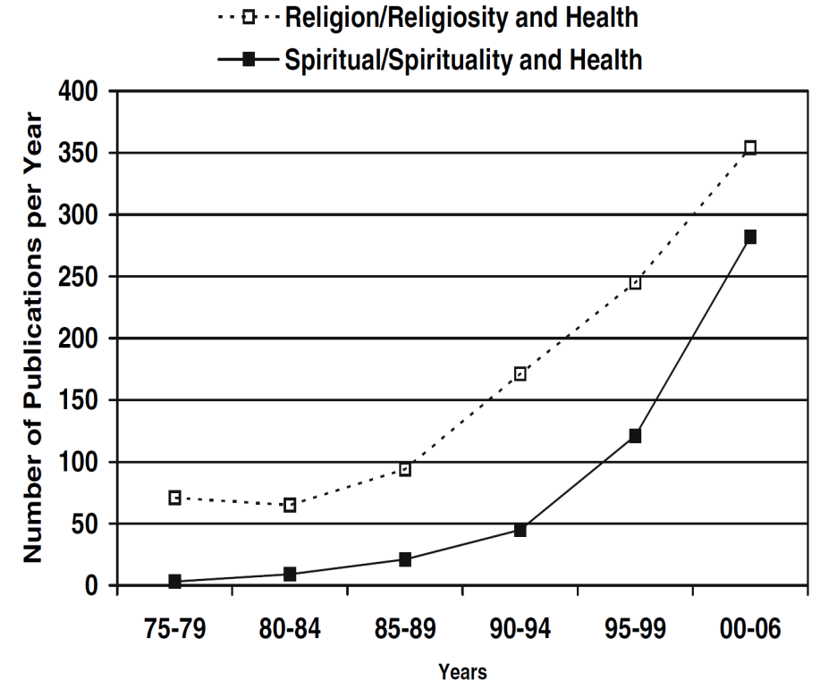
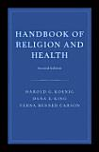
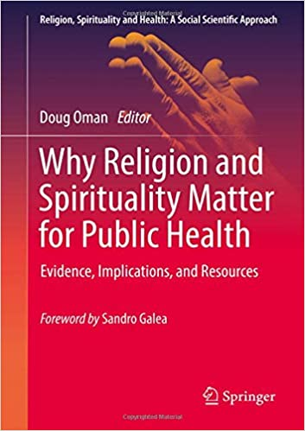
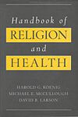
Increased Empirical Study Since 1990s
R/S-health empirical literature:
1200+ studies in 20th century
2000+ additional studies
from 2000 to 2009
 118 systematic reviews
(33 meta-analyses)
Koenig et al (2001).
Handbook of Religion and Health.
Oxford University Press.
Koenig et al (2012),
second edition (Oxford)
Oman (2018), Springer
Notes:
***Figure from Masters, K.S. (2007). Religiosity/spirituality and behavioral medicine: Investigations concerning the integration of spirit with body. Journal of Behavioral Medicine, 30(4), 287-289, doi:10.1007/s10865-007-9116-5.
*Koenig, H.G., McCullough, M.E., & Larson, D.B. (2001). Handbook of religion and health. New York: Oxford University Press.
*Koenig, H.G., King, D.E., & Carson, V.B. (2012). Handbook of religion and health (2nd ed.). Oxford ; New York: Oxford University Press.
*Oman, D. (Ed.). (2018). Why religion and spirituality matter for public health: Evidence, implications, and resources. Cham, Switzerland: Springer International. https://doi.org/10.1007/978-3-319-73966-3
*Oman, D., & Syme, S. L. (2018). Weighing the evidence: What is revealed by 100+ meta-analyses and systematic reviews of religion/spirituality and health? In D. Oman (Ed.), Why religion and spirituality matter for public health: Evidence, implications, and resources (pp. 261-281). Cham, Switzerland: Springer International. https://doi.org/10.1007/978-3-319-73966-3_15

Slide 4
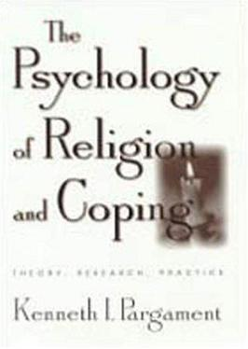
Well-supported pathways
(usually favorable)
Religious or spiritual involvement may affect…
  Social connections and social support
   physical/mental health
  Health behaviors (including diet, exercise, medical appointments, vaccinations)
   physical/mental health
  Coping resources, mental health
  + stress
   physical/mental health
Overweight ~unfavorable
Theological opposition to vaccination per se is rare or non-existent
Yet many states allow “religious” exemptions
Much nuanced theory & evidence on religious coping (Pargament, 1997)
Notes:
*Oman, D. (2018). Model of individual health effects from religion/spirituality: Supporting evidence. In D. Oman (Ed.), Why religion and spirituality matter for public health: Evidence, implications, and resources (pp. 27-63). Cham, Switzerland: Springer International. https://doi.org/10.1007/978-3-319-73966-3_3
*Pargament, K. I. (1997). The psychology of religion and coping: Theory, research, practice. New York: Guilford.

Slide 5
Pathways: How might R/S affect health?
(what “mechanisms”?)
⇨
⇨
⇨
Physical
Health
Spirituality & Religion
R/S Coping
Mental Health
/ Character Strengths

Strength
(occas. direction) influenced by Sociocultural CONTEXT
 reduced stress
Notes:
*Koenig, H. G., McCullough, M. E., & Larson, D. B. (2001). Handbook of Religion and Health. New York: Oxford University Press.
***Oman, D., & Thoresen, C. E. (2002). "Does Religion Cause Health?": Differing Interpretations and Diverse Meanings. Journal of Health Psychology, 7(4), 365-380. doi:10.1177/1359105302007004326
***[a simplified form of the 2002 publication by the same authors:] Oman, D., & Thoresen, C. E. (2007). Does Religion Cause Health? In A. Eisen & G. Laderman (Eds.), Science, religion, and society: An encyclopedia of history, culture, and controversy (Vol. 2, pp. 685-695). Armonk, NY: ME Sharpe.

Slide 6
Cross-Cultural Corroboration: Sites
R/S ↔ smoking*? | Poland, Central America, Mexico, Iran, Israel, Lebanon, South Africa
R/S ↔ alcohol*? | Australia, Finland, Hungary, Poland, Spain, United Kingdom, Brazil, the Caribbean, Central America, Mexico, Israel, Lebanon, Thailand, Turkey, South Africa
R/S ↔ risky sexual activity*? | Australia, Slovakia, the Caribbean, Iran, Israel, Kenya, Malawi, Nigeria
R/S ↔ depression*? | Netherlands, Yugoslavia, Mexico, Iran, Israel, Palestine, Afghanistan, Taiwan
R/S ↔ anxiety*? | Germany, Israel, Afghanistan, Japan, Sri Lanka
R/S ↔ adult well-being? | Uruguay, Kuwait, India, Malaysia, Pakistan, 140+ worldwide
R/S ↔ youth well-being? | Australia, Ukraine, United Kingdom, India, Thailand, Cameroon
R/S ↔ hypertension*? | Greece, Italy, Netherlands, United Kingdom, West Indies, Egypt, Israel, Kuwait, Turkey, India, Japan, Taiwan, Thailand, South Africa
R/S ↔ self-rated health? | Bosnia, Denmark, Finland, Italy, Poland, Scotland, Caribbean, Latin America, Mexico, Israel, Taiwan
*reduced
Notes:
*Oman, D. (Ed.). (2018). Why religion and spirituality matter for public health: Evidence, implications, and resources. Cham, Switzerland: Springer International. https://doi.org/10.1007/978-3-319-73966-3
*Grant, L., & Oman, D. (2018). International and global perspectives on spirituality, religion, and public health. In D. Oman (Ed.), Why religion and spirituality matter for public health: Evidence, implications, and resources (pp. 447-462). Cham, Switzerland: Springer International. https://doi.org/10.1007/978-3-319-73966-3_27
DERIVED FROM
*Koenig, H.G., McCullough, M.E., & Larson, D.B. (2001). Handbook of religion and health. New York: Oxford University Press.
*Koenig, H.G., King, D.E., & Carson, V.B. (2012). Handbook of religion and health (2nd ed.). Oxford ; New York: Oxford University Press.

Slide 7
Divine Forces
(immanent or transcendent)
Evidence currently insufficient
Where is prayer?
(implicit already?)
Controversial
⇨
⇨
⇨
Physical
Health
Spirituality & Religion
R/S Coping
Mental Health
/ Character Strengths

Strength
(occas. direction) influenced by Sociocultural CONTEXT
 reduced stress
Notes:
*Koenig, H. G., McCullough, M. E., & Larson, D. B. (2001). Handbook of Religion and Health. New York: Oxford University Press.
***Oman, D., & Thoresen, C. E. (2002). "Does Religion Cause Health?": Differing Interpretations and Diverse Meanings. Journal of Health Psychology, 7(4), 365-380. doi:10.1177/1359105302007004326
***[a simplified form of the 2002 publication by the same authors:] Oman, D., & Thoresen, C. E. (2007). Does Religion Cause Health? In A. Eisen & G. Laderman (Eds.), Science, religion, and society: An encyclopedia of history, culture, and controversy (Vol. 2, pp. 685-695). Armonk, NY: ME Sharpe.

Slide 8
Conclusion
Does science say that religious or spiritual (R/S) involvement makes us healthy?
  YES for social support, health behaviors, and or coping/mental health,
  although strength (+even direction) may vary
    Insufficient/weak evidence for (intercessory) prayer-at-a-distance
This framework “works” across almost all traditions
THANK YOU
Something we all have in common
Slides posted on “Talks” tab at: http://dougoman.org
Notes:
*Oman, D. (2018). An evidence-based course at U.C. Berkeley on religious and spiritual factors in public health. In D. Oman (Ed.), Why religion and spirituality matter for public health: Evidence, implications, and resources (pp. 383-395). Cham, Switzerland: Springer International. https://doi.org/10.1007/978-3-319-73966-3_22

